Slide 1
DPM Final Project – Week 6
TEAM 11

Slide 2
BETA Demo adjustments
Demo failed due to error in the Wi-Fi class
Failed to test appropriately the Wi-Fi class
Testing was done on navigation and localization but without using Wi-Fi

Slide 3
Gantt Chart Final Update
Refer to Application

Slide 4
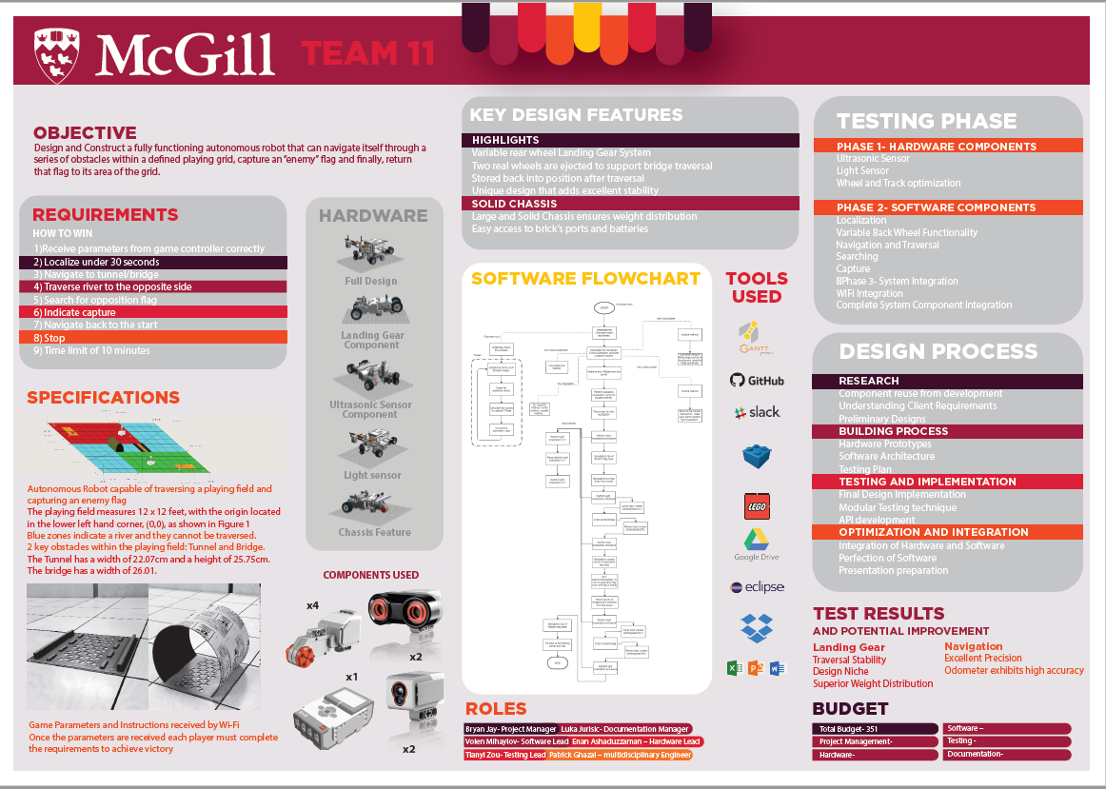
Current Status – Final Days
Currently in our final development and testing phase
Search & Localize testing
End-to-end testing
Poster is complete
Documents are up to date
Updating testing

Slide 5
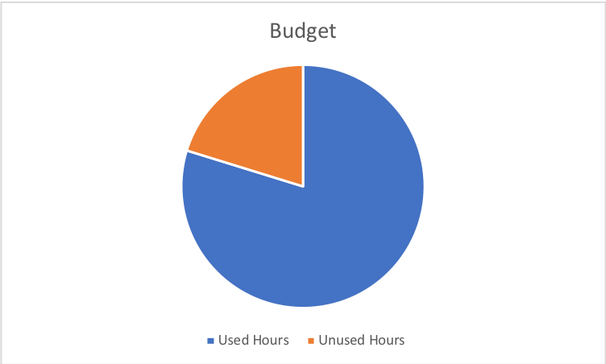
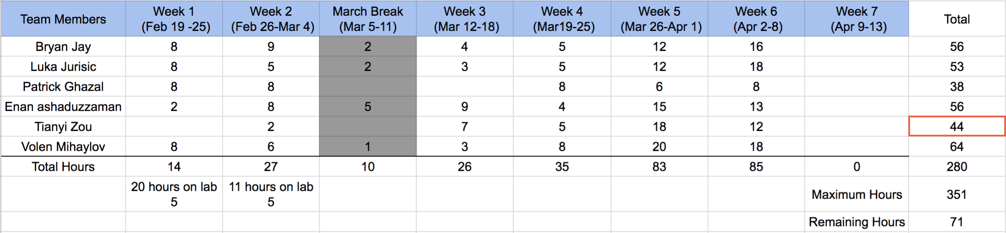
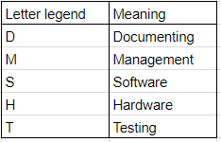
Budget Update

Slide 6
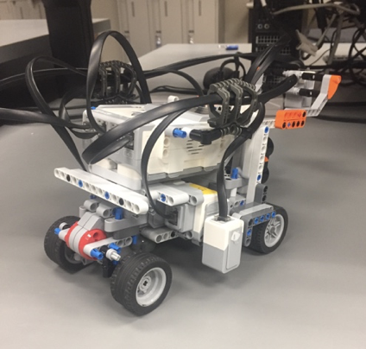
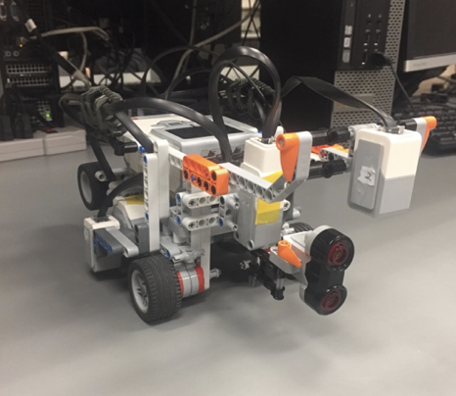
Hardware Status & Updates
Hardware Version 2.0 and 2.1 Introduced
Marble was adjusted so that the robot can be more leveled. Got rid of multiple issues
Condensed the robot by getting rid of excess parts
Light Sensors are behind the wheels
Rotating Ultrasonic Sensor moved to the front of the robot.
Guard Rails Implemented to easily traverse both tunnel and bridge.

Slide 7
Status of Software Development
Implemented:
Robot Class, Odometry, Controller, Navigation, Wi-Fi Class, Light & US Localization
To Complete:
Search & Localize, Robot Avoidance

Slide 8
Testing Status
Wi-Fi Class is now fully tested properly
Obstacle traversal, Navigation, Localization tested
To Do:
Update documentation of all tests done and the tests to be done
Search & localize testing
End-to-End testing

Slide 9
Next Steps
Small Adjustments to the poster
Fully presentable Documents
Putting the code together
Testing as many cases as possible that may occur during the competition
Ambient lighting

Slide 10
Thank You!

